Slide 1
STUDY PROCESS ORGANIZATION AT THE FACULTY OF BUSINESS, MANAGEMENT AND ECONOMICS
2020./ 2021.

Slide 2
EPIDEMIOLOGICAL SAFETY MEASURES FOR THE CONTAINMENT OF THE SPREAD OF COVID-19 INFECTION

Slide 3
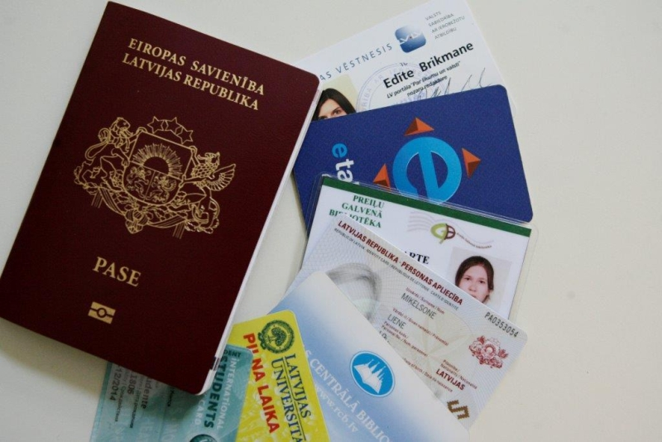
TAKE YOUR STUDENT ID CARD WITH YOU
At the premises of the UL Faculty of Business, management, and economics there will be present safety staff, who will be checking personal identity documents and in case if necessary check person’s body temperature.
Don't forget to prolong your student ID card!

Slide 4
AT THE PREMISES OF THE FBME THERE ARE AVAILABLE HANDS AND SURFACE DISINFECTANTS!!!

Slide 5
BE SAFE AND DO NOT ENDANGER OTHERS!
If you have increased body temperature and you are experiencing typical Covid-19 symptoms (such as fever, cough, sore throat, or difficulty breathing), the student must immediately inform the lecturer or study secretary at the Study Center, Room 312!
You must leave the FBME premises and contact your family doctor to have a health check!
It is allowed to return to FBME premises only upon presentation of doctor's certificate of health condition or a negative result of the Covid-19 test!

Slide 6
CHANGES IN STUDY ENVIRONMENT!
Follow up to changes in FBME library office hours www.biblioteka.lu.lv. Use electronically available resources. Take into account, that books also will have quarantine time.
Canteen of the FBME will be working as usual, but the wardrobe will be closed.
All lecture rooms will be open, but your personal belongings are your own responsibility!
Student recreational areas are closed!

Slide 7
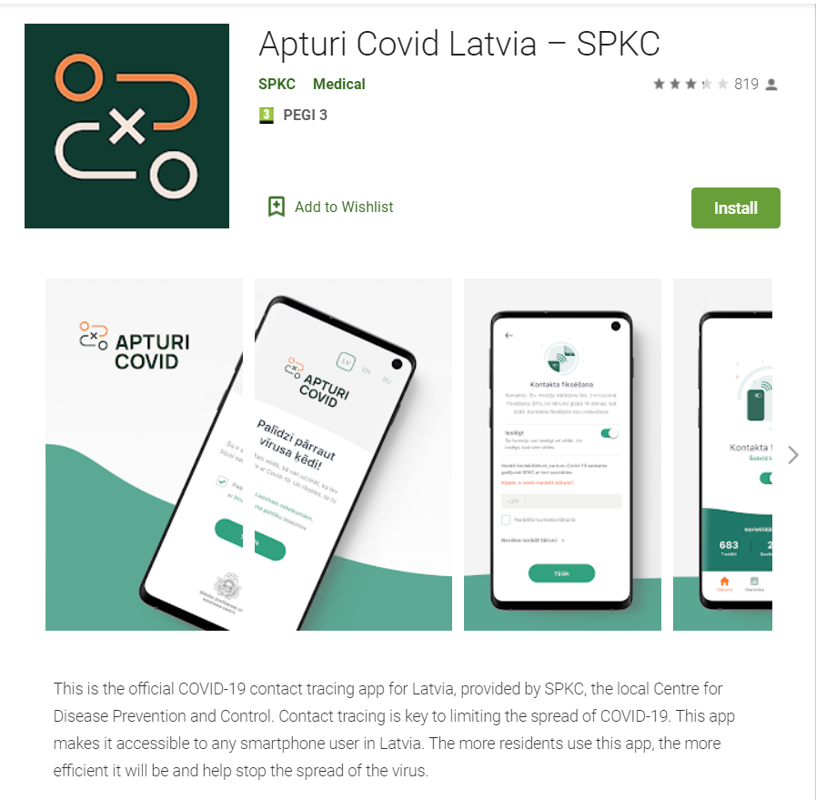

Slide 8
ORGANIZATION OF STUDY PROCESS

Slide 9
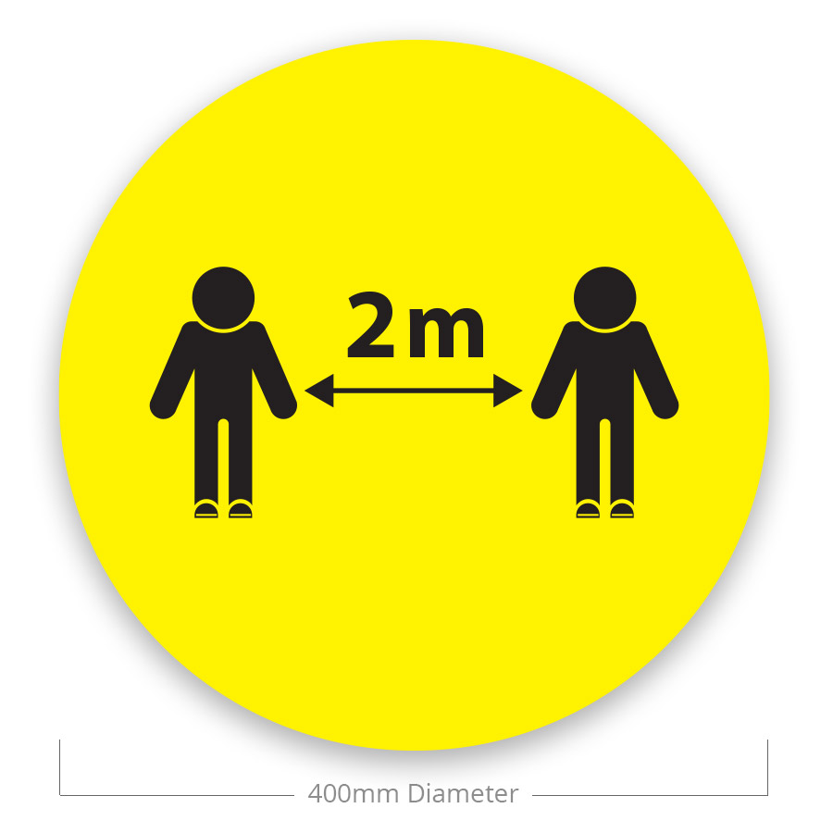
STUDIES TAKES PLACE IN PERSON, EXCEPT OF CASES SPECIFIED IN DEAN’S PRECEPT!
Studies take place in person according to study programme plans and schedules:
In student groups, with less than 50 persons in the room, 2 meters distance is not mandatory
In student groups, with more than 50 persons but less than 250, with ensured 2 meters distance between students and lecturer.
All groups, with ensured 2 meters distance between students and lecturer. (students do not sit in first row)

Slide 10
ENSURE DISTANCE/ONLINE STUDIES ACCORDING TO SCHEDULES!
For student groups, in which more than 50% of students can't be present due to epidemiological restrictions
For student groups, where study course academic staff member is in self-isolation or quarantine;
In cases, when one lecture is distance/online, all other lectures scheduled the same day, are provided in distance/online;
For student groups, where courses are scheduled together with different study year, study programme students and it is not possible to ensure 2 meters distance between different student groups.

Slide 11
OBLIGATIONS FOR STUDENTS!!!
Follow up updated information provided by the UL and FBME!
Each day after 17:00 check information on possible changes in lecture schedules;
1st-year bachelor and master level students participate in all info seminars organized by the FBME!
Follow directions at premises in the FBME – 1st-year students use central stairs.

Slide 12
OBLIGATIONS FOR STUDENTS!!!
All classrooms will be open, providing students with the opportunity to stay in classrooms before lectures and also between lectures, except for computer classes.
Full-time classes, which at the same time by several student groups to take their seats in the lecture room according to the planned division of the group and keep two meters distance
Students who are unable to participate in the study process may be provided with individual and examination plans

Slide 13
ACADEMIC INTEGRITY

Slide 14
Academic staff members carry out continuous control of academic integrity during the study process!
All violations are recorded and reviewed at the FBME or UL level according to the UL Code of Academic Ethics!
Each UL academic staff members have access to a plagiarism control program
Plagiarism check is mandatory:
Before final thesis defence session;
After final thesis defence session, if a complaint is received.
THE CONTROL OF ACADEMIC INTEGRITY AND PLAGIARISM!

Slide 15
COMMUNICATION AND ETHICS
It is important to use LU e-mails in communication, which reduces the possibility of problems and conflicts of academic ethics;
Academic ethics must also be observed in social network communication - the UL Academic Ethics Commission is preparing guidelines for the use of social networks!

Slide 16
THANK YOU FOR ATTENTION!

